Slide 1

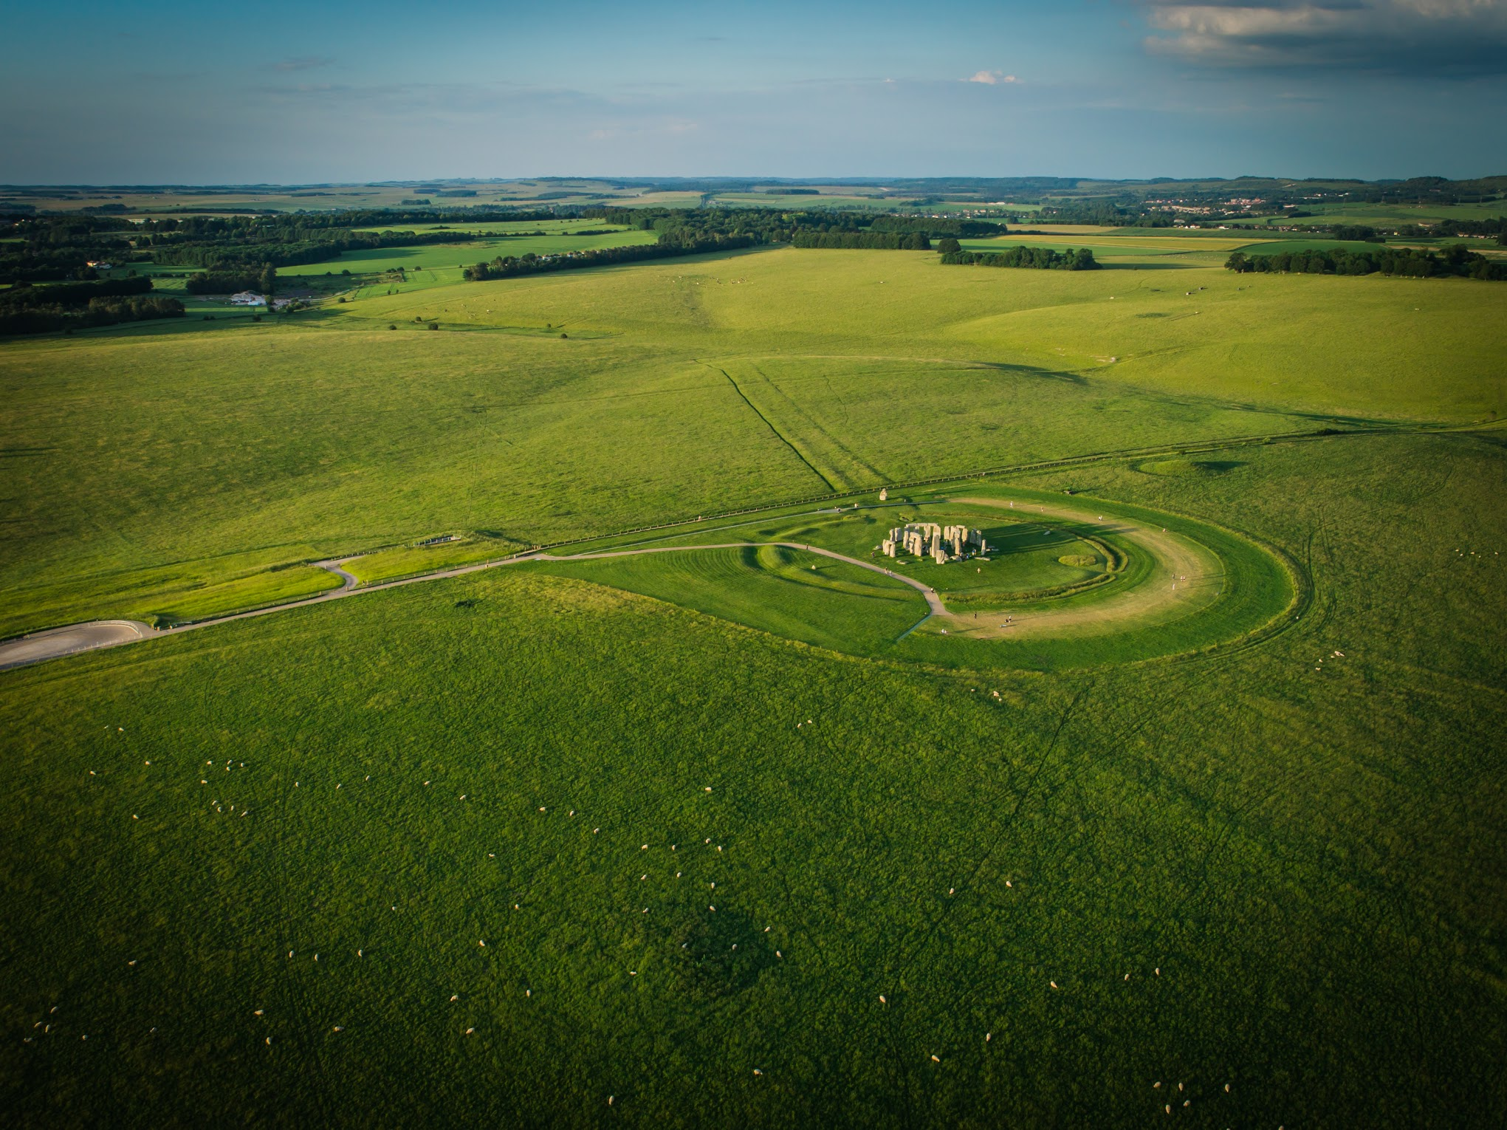

Effective Reviews and
Panels
Course Contents:
Research Expertise - Classifications and keywords
Review process
  Requirements of reviewers
  Summary – key points
Panel meetings
  Panellist requirements
  Summary – key points
Mock panel meeting

Slide 2
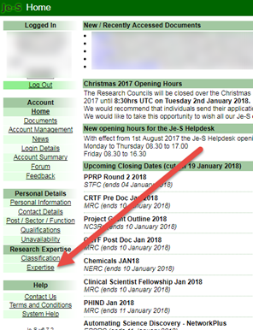
Research Expertise
Up to date and comprehensive – regularly review, think about how your expertise/areas in which you work change
Used in generating your review requests
Low/High number of requests – raise with AHRC

Slide 3


Reviewer Matching
Compares classification of application with PRC members’ classifications
Higher the number of classifications matched, higher up the list of potential reviewers
Drill down to an individual’s classification, qualifiers and keywords
Cross matched with description in proposal summary document
Other checks
  Unavailability
  Number of current review invitations
  Max 8 in last 12 months
  Conflicts of interest

Slide 4
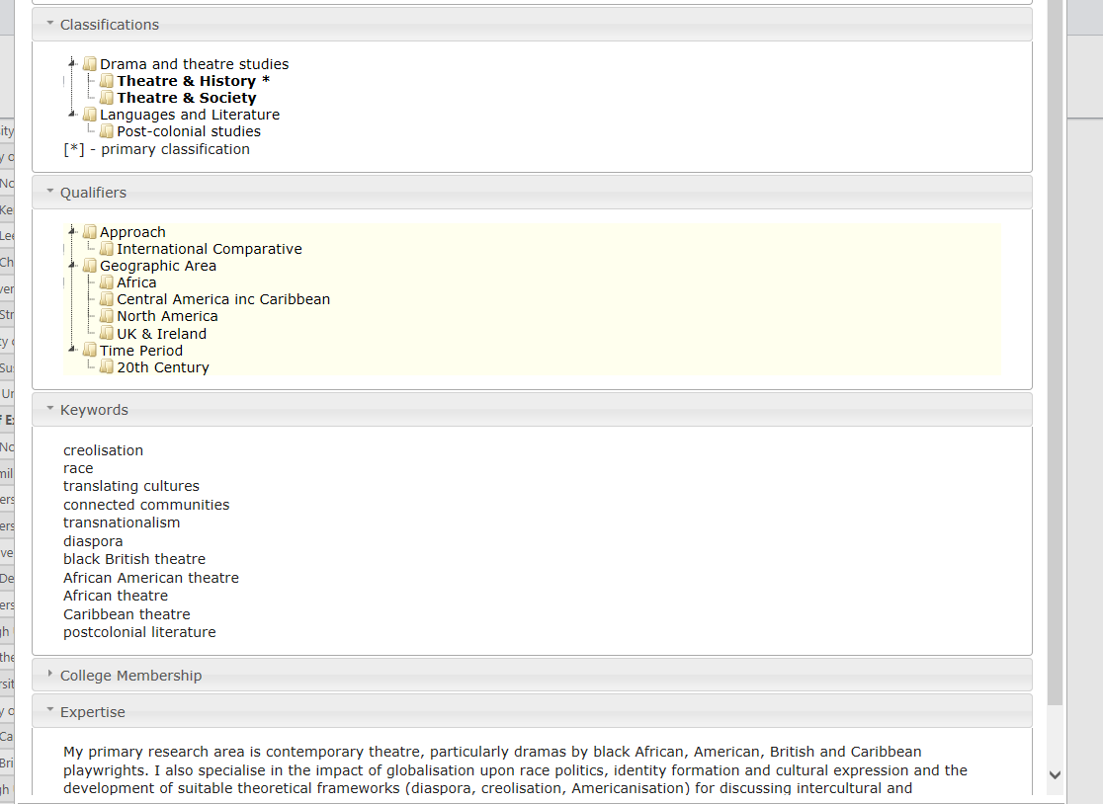
Expertise screen – AHRC view

Slide 5
Reviewing applications
2019 figures
  Number of review requests – 3105
  Average of 3.2 invitations per member
  43.2% decline rate
    32% outside area of expertise
    39% too busy
    10% conflict of interest
    11% other
    8% did not respond
Unusable reviews
  Unusable – conflicts after review; returned for amendment with no response
15 working days target; average – 26.5 working days

Slide 6
Review process – initial action
Familiarise yourself with the UKRI Principles of Assessment and Decision Making
Prompt response to invitation
  Accept before starting the review – AHRC know
  you are doing it
  Decline as soon as possible
  Ask for extension (possible alternative to decline)
  AHRC management of alternative reviewers
Chase emails
  system automated
  follow up by AHRC staff
Check conflicts of interest
  On receipt of invitation and prior to starting a review
  If in doubt, ask AHRC
PLEASE DON’T – request an extension and then decline as the extension date is reached

Slide 7
Review process – What makes
a good review?
Strategic aims of the call/scheme
Use of grading descriptors
Evaluate rather than reiterate
Evidence-based to support observations
Detail relates to headings on review form
Strengths and weaknesses of applications
Contextualise within current work in the field
Interdisciplinary coherence
Comprehensive comments for comparison at panel
Receptive to new ideas and approaches/methodology
Aware of own biases – unconscious bias
Raise issues requiring PI clarification
Non-expert panel member - understanding and grading

Slide 8

Review process – returned reviews
Contradictory comments and grades
  Unfundable quality but fundable grade
Appearing to advise the applicant
Questioning remit of proposal
Brief comments (as opposed to concise)
  Insufficient detail for PI response and panel to use
Confrontational or emotive tone and language
Specific comments regarding AHRC processes and policies
Comments made are speculative or don’t relate to the content or context of the proposal
Inconsistent Confidence levels and comments
  Demonstrate expert understanding of as section but mark as low level of confidence.
Online training: https://ahrc.ukri.org/peerreview/peer-review-resources/ - detailed information by form category

Slide 9
Summary - reviews
Accept/decline on receipt of invitation
Make use of extension requests
Check for conflicts on receipt of invitation, before starting review
Use your own expertise and knowledge
Raise questions for PI where applicable
Comprehensive comments, match grading
Use of Funding Guide, Online training, Peer Review Handbook, AHRC staff
PUT YOURSELF IN THE APPLICANTS’ SHOES

Slide 10

Panel Selection process
Non-standing (ad hoc) panels
Chair – Experienced panellist/Subject leader Panellists
Panellists – number proportionate to number of applications
Use of classifications in line with proposals being considered
PRC members – off college exception
No panel member who has submitted a review to the same meeting
No panel member with multiple conflicts of interest

Slide 11
Types of Panel Meetings
Moderation Panel
- Research Grants
- Research, Development & Engagement Fellowships
- Follow-on-Funding (over £30k)
- Thematic Calls
Assessment Panel
- Follow-on-Funding (under £30k)
Thematic Calls

Slide 12
Panel Meeting - roles
  Chair
    Runs meeting
    Clarifies scoring and oversees ranking
  Panellists
    Introduce applications
      Primary Introducer
      Secondary Introducer
      Supporting Introducer
  Agree final grading and ranking – fundability
AHRC Staff
  Advise on policy and process questions
  Executive team agrees final funding decisions

Slide 13
Panel Meeting - Preparation
Familiarise yourself with the UKRI Principles of Assessment and Decision Making
4-6 weeks papers are made available
- Extranet:
  proposals
  reviews & PI Responses for moderating panels
  any additional information e.g. call specific guidance
Focus - to moderate/assess all proposals you are introducing plus read as many other proposals as possible
Pre-scores (where used) – decimal points
Read scheme/call guidance
Make notes
  in case of non-attendance
  Use of supplied form for format

Slide 14
Final points - panels
Conflicts of interest
  Disclose any conflicts of interest or knowledge of the applicant(s).
  Refer to peerreviewcollege@ahrc.ukri.org or website
All the documents and discussions which form the meeting are confidential
  Information acquired and generated whilst writing review
  Covers fact applicant has applied
  Content of applications
  All downloaded proposals must be deleted or printed ones left after meeting
Impartiality
  Assess application solely on own merits, according to assessment criteria

